Slide 1
Digital Voting using Blockchain technology
Presented By:
Rakshit Sharma (IT/33/15)
Baljeet Singh (IT/26/15)
Ashutosh Rahi (IT/31/15)
Under the supervision of
Ms. Iqra Altaf Gillani

Slide 2
Outline
Why this project
Introduction
Blockchain as a service
Literature Survey
Methodology
References

Slide 3
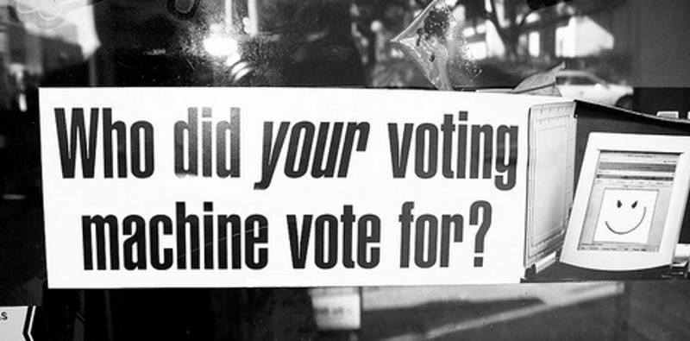
Why this project?
Issues with current voting system:
Rigged Elections.
Fake Voting.
Voters have to physically report to polling booths.

Slide 4
Introduction: What can be done?
Using Decentralization.
Blockchain is a perfect solution.
Problem statement: To design a system using which online app-based voting could be done in a secure way; & which could provide a fool-proof digital-identification system.

Slide 5
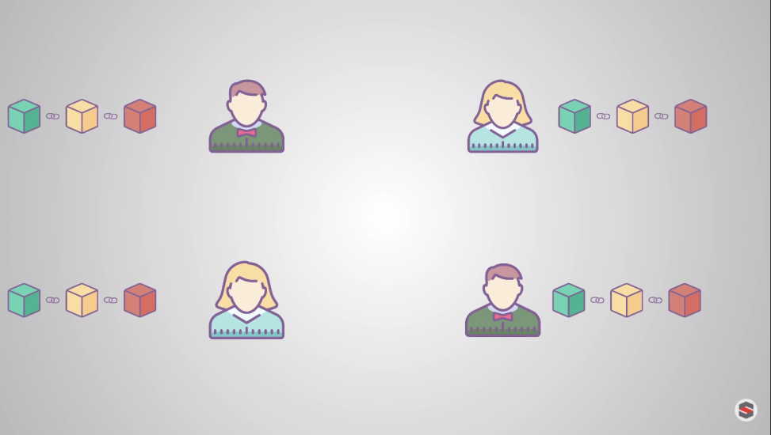
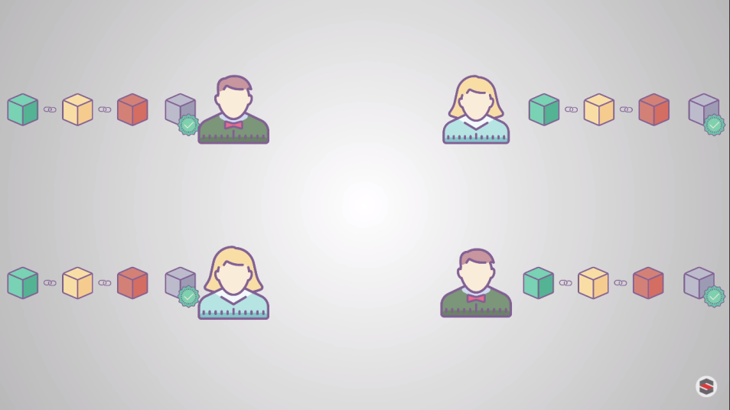
Blockchain as a service
A distributed database of records of all transactions or digital event that have been executed and shared among participating parties.
Each transaction verified by the majority of participants of the system.

Slide 6
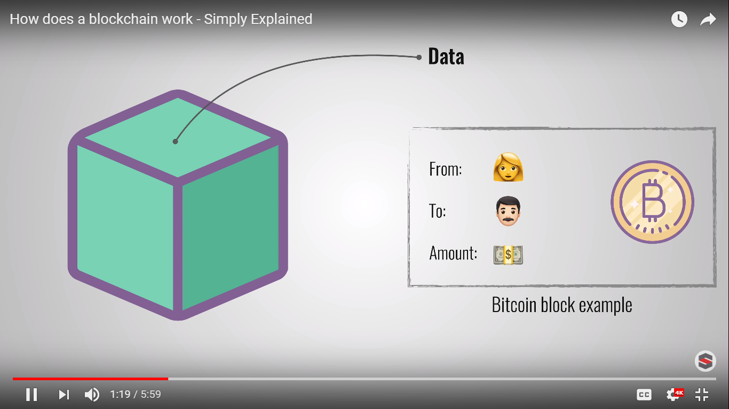
Blockchain as a service

Slide 7
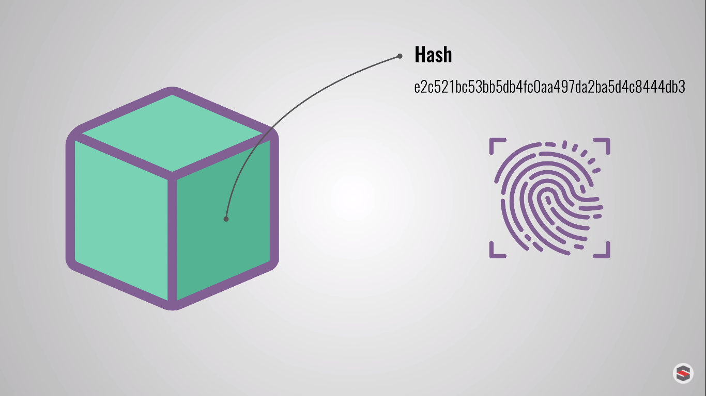
Blockchain as a service

Slide 8
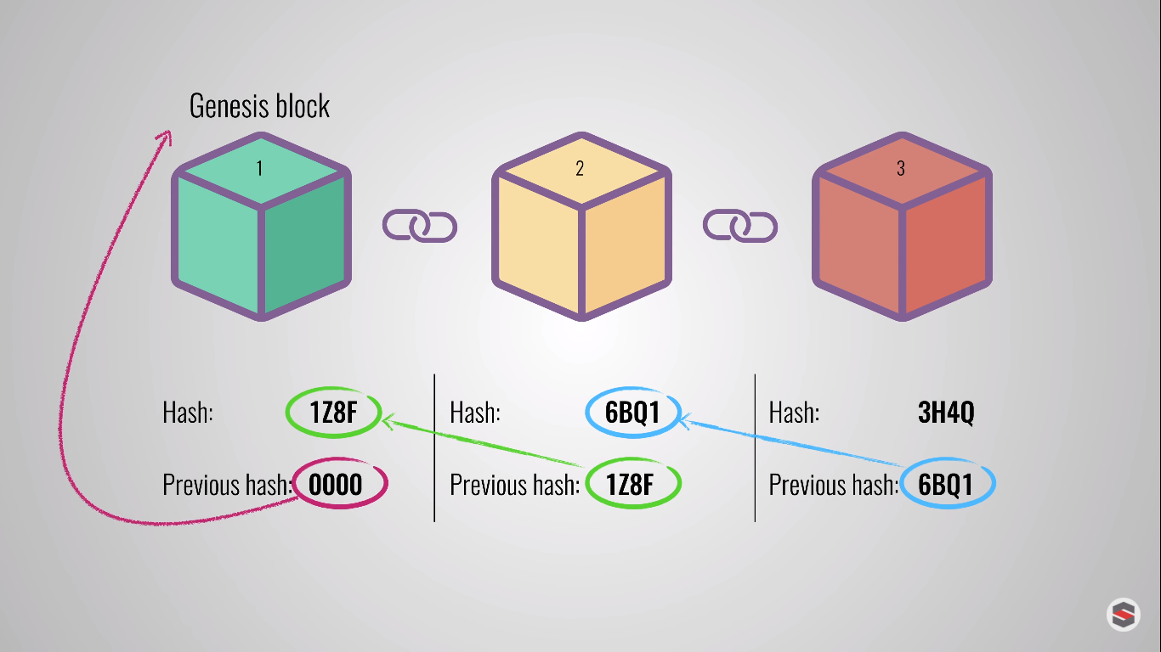
Blockchain as a service

Slide 9
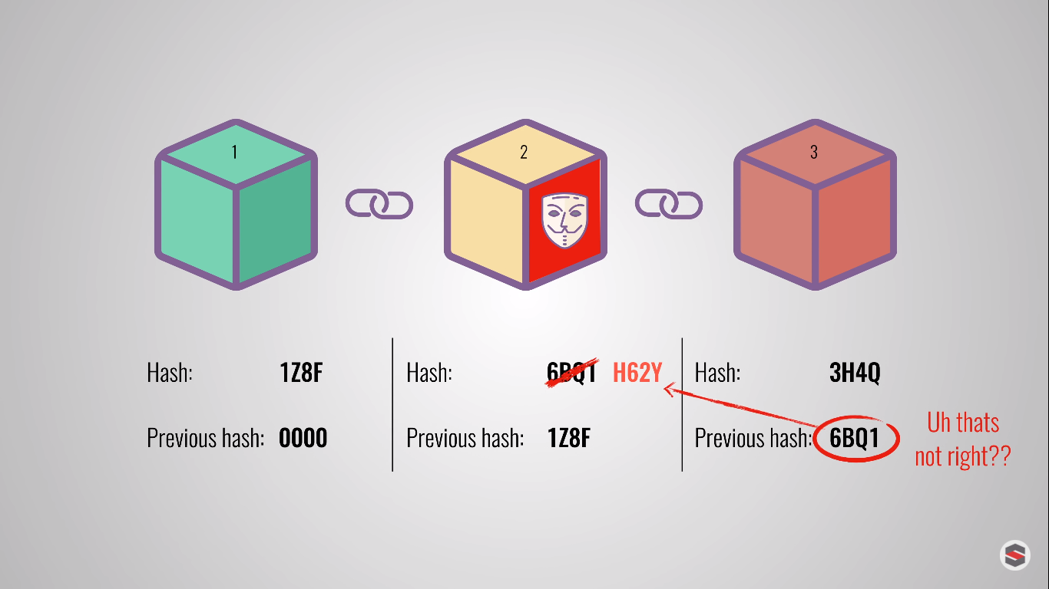
Blockchain as a service

Slide 10
Literature Survey
FollowMyVote:
Voter installs polling booth (an app) on device.
Verification using documents.
Allows changing the vote before a specified deadline.
Most recent vote will be counted.
Too many security flaws – authentication is hard, coerce voting is possible.
Tried to conduct parallel U.S. presidential elections (2016), but failed to meet deadline.
Turns out to be ineffective.

Slide 11
Literature Survey
Polys: A third-party voting app, which conducts online blockchain based voting.
Sagar Shah et al use fear detection using Machine Learning to prevent coerce voting.

Slide 12
Methodology
Parts of architecture:
User
Authentication Server
Arbitration Server
Blockchain System

Slide 13







Methodology
2
3
A.S.
BACKEND-DATABASE
1
4
USER
OR
5
8
6
7
A.R.
PRIVATE-BLOCKCHAIN
LOCAL POLLING BOOTH

Slide 14
Project Outcomes
Less tedious, more economical.
Voters abroad can also vote.
Ease for physically challenged voters.
No Fake voters!

Slide 15
References
Images on slides 6-9: Courtesy of Simply Explained (available at: https://www.youtube.com/watch?v=SSo_EIwHSd4)
Shah, S., Kanchwala, Q. and Mi, H. (2018). Blockchain Voting System.
Osgood, R. (2018). The Future of Democracy: Blockchain Voting.
Blockgeeks. (2018). Basic Primer: Blockchain Consensus Protocol - Blockgeeks. [online] Available at: https://blockgeeks.com/guides/blockchain-consensus/ [Accessed 7 Nov. 2018].

Slide 16
Thank you! Have a nice day!!

